Slide 1
ATAI
Advanced Techniqueof Artificial Intelligence
ATAI
ChongqingUniversity _{AdvancedTechniqueof}
of Technology Artificial Intelligence
Chongqing University of
Technology
Chongqing University ^{ATAI}
_{of Technology} Advanced Techniqueof
Artificial Intelligence
Chongqing University of Technology
Chongqing University of Technology
PromptMM: Multi-Modal Knowledge Distillation for
Recommendation with Prompt-Tuning
—— WWW 2024
Code: https://github.com/HKUDS/PromptMM
2024.5.9 •ChongQing
Reported by Ling Tan
1

Slide 2
ATAI
AdvancedTechniqueof
Artificial Intelligence
ATAI
ChongqingUniversity _{AdvancedTechniqueof}
of Technology Artificial Intelligence
ChongqingUniversity of Technology
Motivation
（1） Overfitting & Sparsity.
Current multi-modal works carry additional high-dimensional feature reduction layers. These additional parameters aggravated overfitting that already exists due to data sparsity, further increasing the difficulty of convergence.
（2）Noise & Semantic Gap.
As side information, multimedia content has inherent inaccuracies and redundancies when modeling user preference with collaborative relations.
The multi-modal context and u-i collaborative relations are originally derived from two different distributions with a large semantic gap.

Slide 3
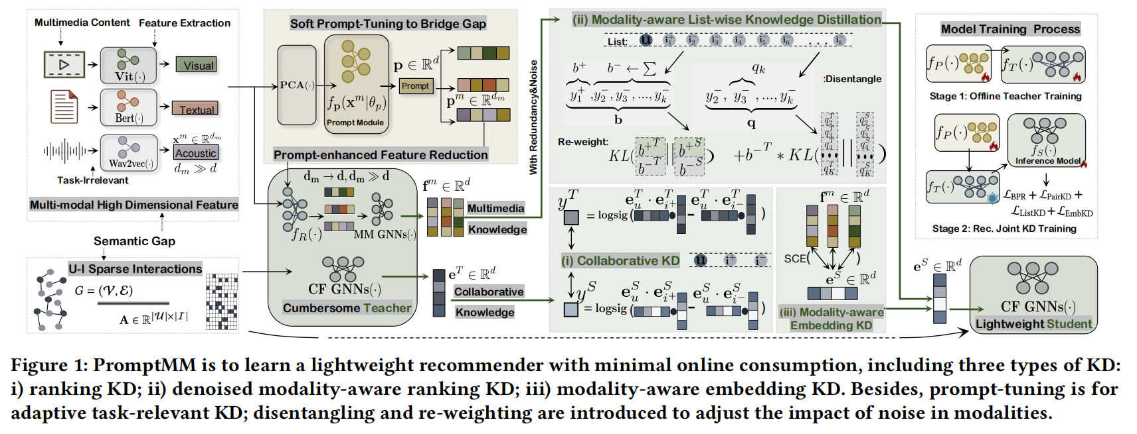
ChongqingUniversity of Technology
ATAI
AdvancedTechniqueof
Artificial Intelligence
ATAI
ChongqingUniversity _{AdvancedTechniqueof}
of Technology Artificial Intelligence
Overview

Slide 4
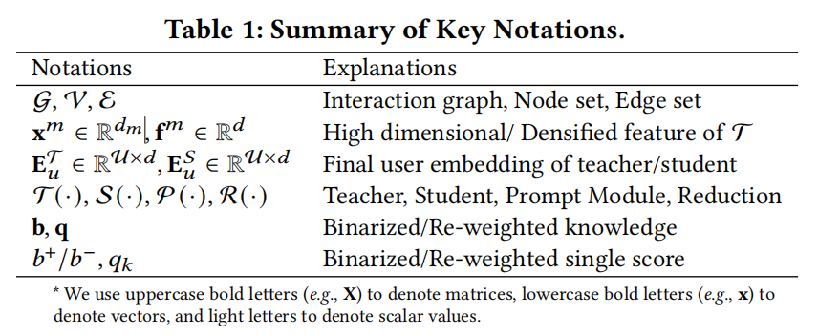
ChongqingUniversity of Technology
ATAI
AdvancedTechniqueof
Artificial Intelligence
ATAI
ChongqingUniversity _{AdvancedTechniqueof}
of Technology Artificial Intelligence
Method

Slide 5
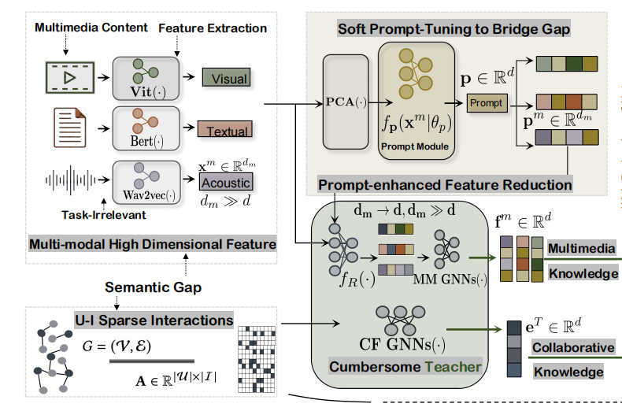
ChongqingUniversity of Technology
ATAI
AdvancedTechniqueof
Artificial Intelligence
ATAI
ChongqingUniversity _{AdvancedTechniqueof}
of Technology Artificial Intelligence
Method

Slide 6
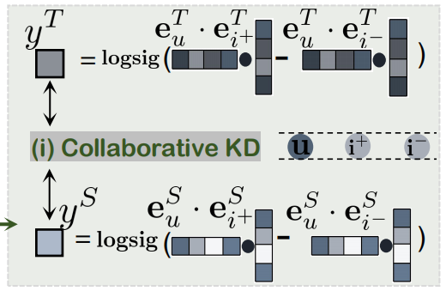
ChongqingUniversity of Technology
ATAI
AdvancedTechniqueof
Artificial Intelligence
ATAI
ChongqingUniversity _{AdvancedTechniqueof}
of Technology Artificial Intelligence
Method

Slide 7
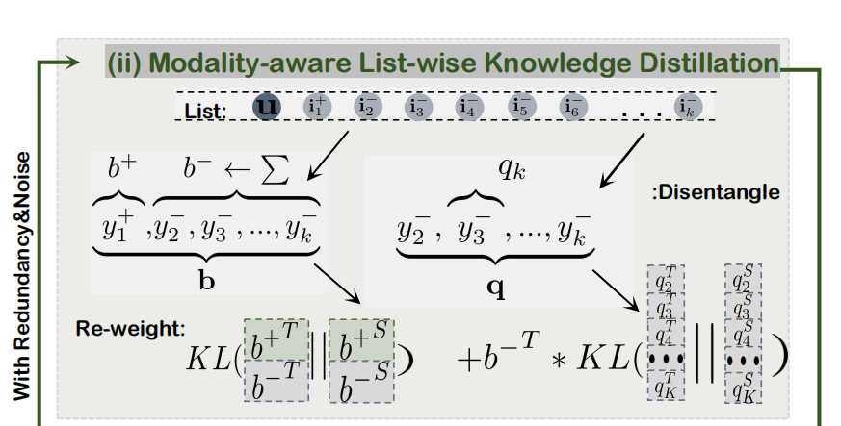
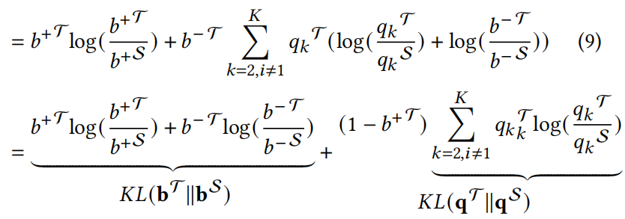
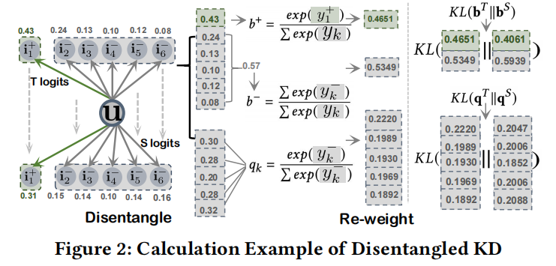
ChongqingUniversity of Technology
ATAI
AdvancedTechniqueof
Artificial Intelligence
ATAI
ChongqingUniversity _{AdvancedTechniqueof}
of Technology Artificial Intelligence
Method

Slide 8
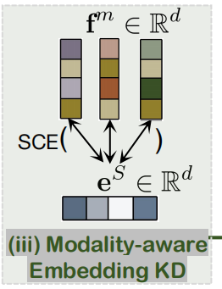
ChongqingUniversity of Technology
ATAI
AdvancedTechniqueof
Artificial Intelligence
ATAI
ChongqingUniversity _{AdvancedTechniqueof}
of Technology Artificial Intelligence
Method

Slide 9
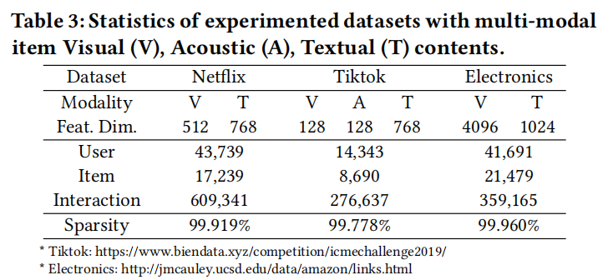
ATAI
AdvancedTechniqueof
Artificial Intelligence
ATAI
ChongqingUniversity _{AdvancedTechniqueof}
of Technology Artificial Intelligence
ChongqingUniversity of Technology
Experiments

Slide 10
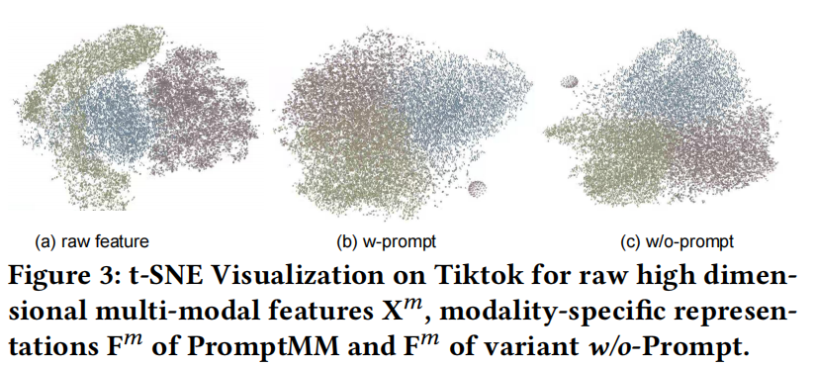
ATAI
AdvancedTechniqueof
Artificial Intelligence
ATAI
ChongqingUniversity _{AdvancedTechniqueof}
of Technology Artificial Intelligence
ChongqingUniversity of Technology
Experiments

Slide 11
ATAI
AdvancedTechniqueof
Artificial Intelligence
ATAI
ChongqingUniversity _{AdvancedTechniqueof}
of Technology Artificial Intelligence
ChongqingUniversity of Technology
Experiments

Slide 12
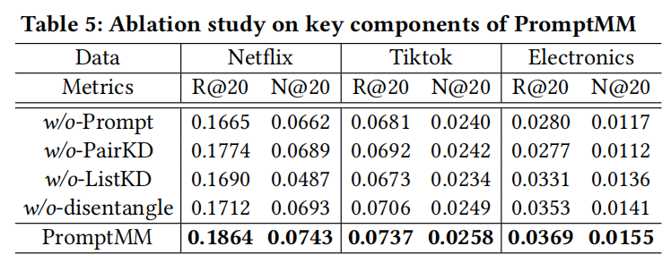
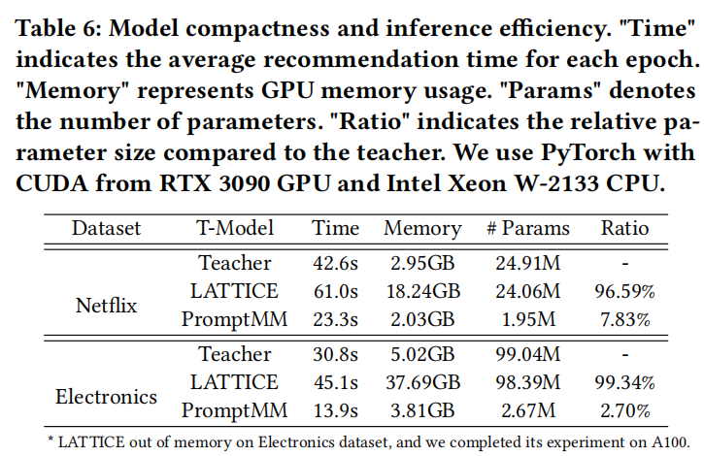
ATAI
AdvancedTechniqueof
Artificial Intelligence
ATAI
ChongqingUniversity _{AdvancedTechniqueof}
of Technology Artificial Intelligence
ChongqingUniversity of Technology
Experiments

Slide 13
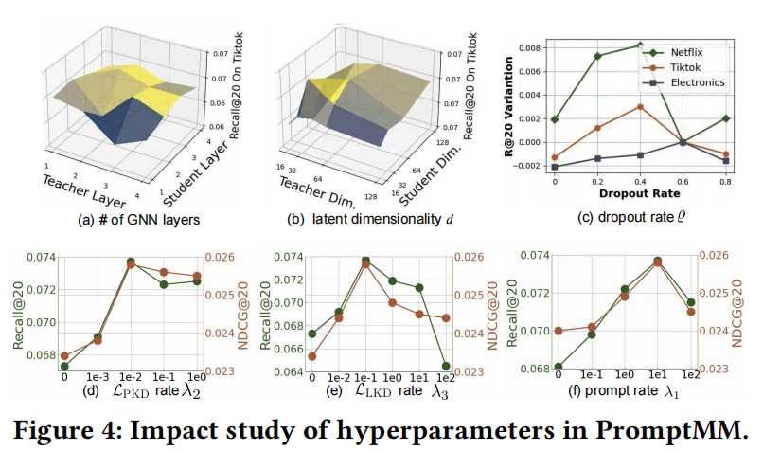
ATAI
AdvancedTechniqueof
Artificial Intelligence
ATAI
ChongqingUniversity _{AdvancedTechniqueof}
of Technology Artificial Intelligence
ChongqingUniversity of Technology
Experiments

Slide 14
ATAI
AdvancedTechniqueof
Artificial Intelligence
ATAI
ChongqingUniversity _{AdvancedTechniqueof}
of Technology Artificial Intelligence
ChongqingUniversity of Technology
Experiments

Slide 15
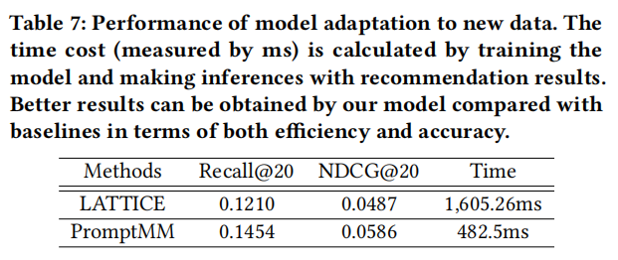
ATAI
AdvancedTechniqueof
Artificial Intelligence
ATAI
ChongqingUniversity _{AdvancedTechniqueof}
of Technology Artificial Intelligence
ChongqingUniversity of Technology
Experiments

Slide 16
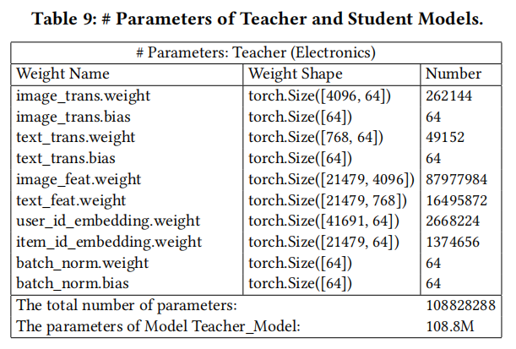
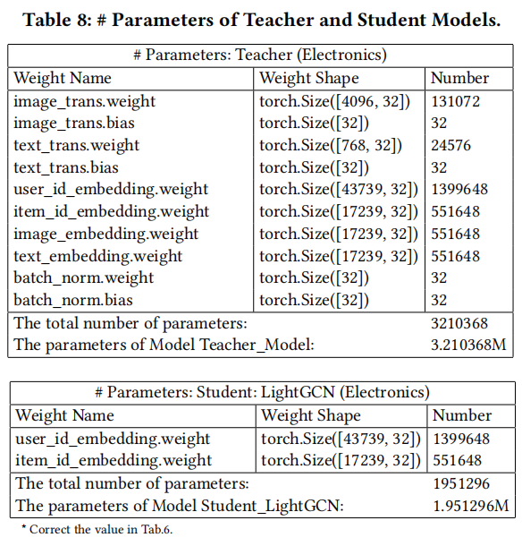
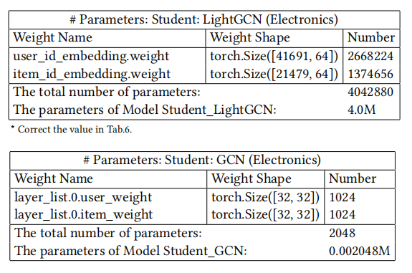
ATAI
AdvancedTechniqueof
Artificial Intelligence
ATAI
ChongqingUniversity _{AdvancedTechniqueof}
of Technology Artificial Intelligence
ChongqingUniversity of Technology
Experiments

Slide 17
ChongqingUniversity of Technology
ATAI
AdvancedTechniqueof
Artificial Intelligence
ATAI
ChongqingUniversity _{AdvancedTechniqueof}
of Technology Artificial Intelligence
Thanks!

